Slide 1
FIREBASE AUTHENTICATION
Prepared by Kerolos Sarwat

Slide 2
Agenda
01 Introduction to Firebase
02 Installation
03 Login Authentication
04 Let’s code

Slide 3
01
Introduction

Slide 4

How to make our app connected to internet
First, We need Backend Developer to Create database and APIs we use in Our App.

Slide 5
The Foundation of Firebase
The process of Backend Development is expensive, Because it needs Backend Developer and Host Server.
So, Google created Firebase to provide developers with a robust, scalable backend platform that simplifies the development process

Slide 6
02
Installation

Slide 7
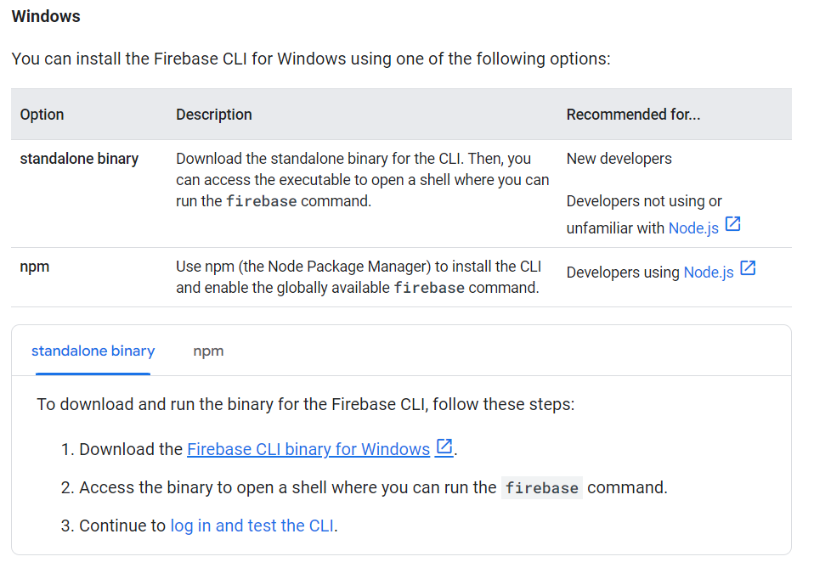
Install Firebase
First, We need to install Firebase

Slide 8
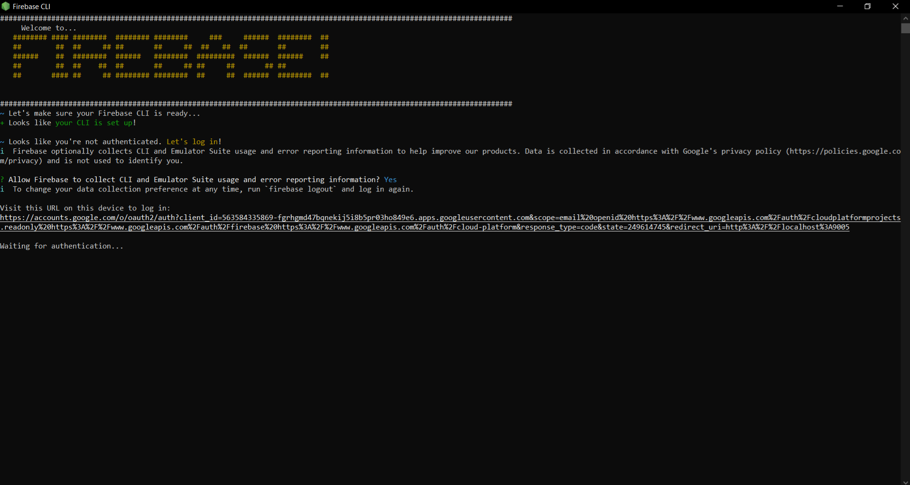
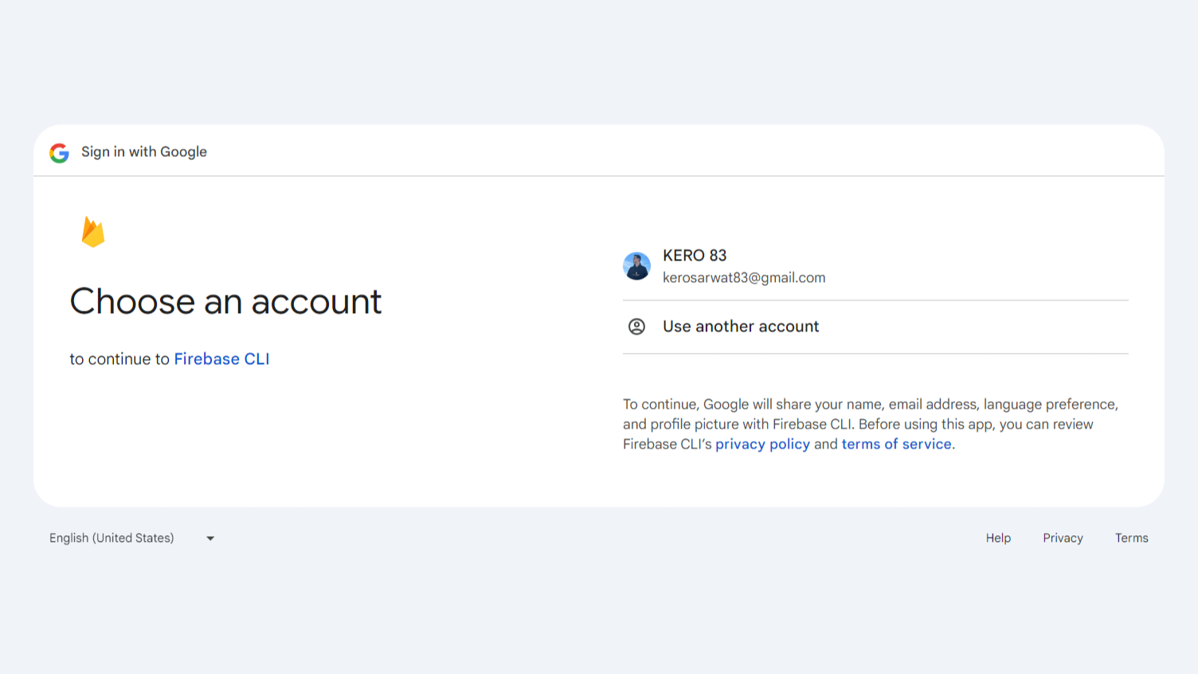
Firebase Login

Slide 9
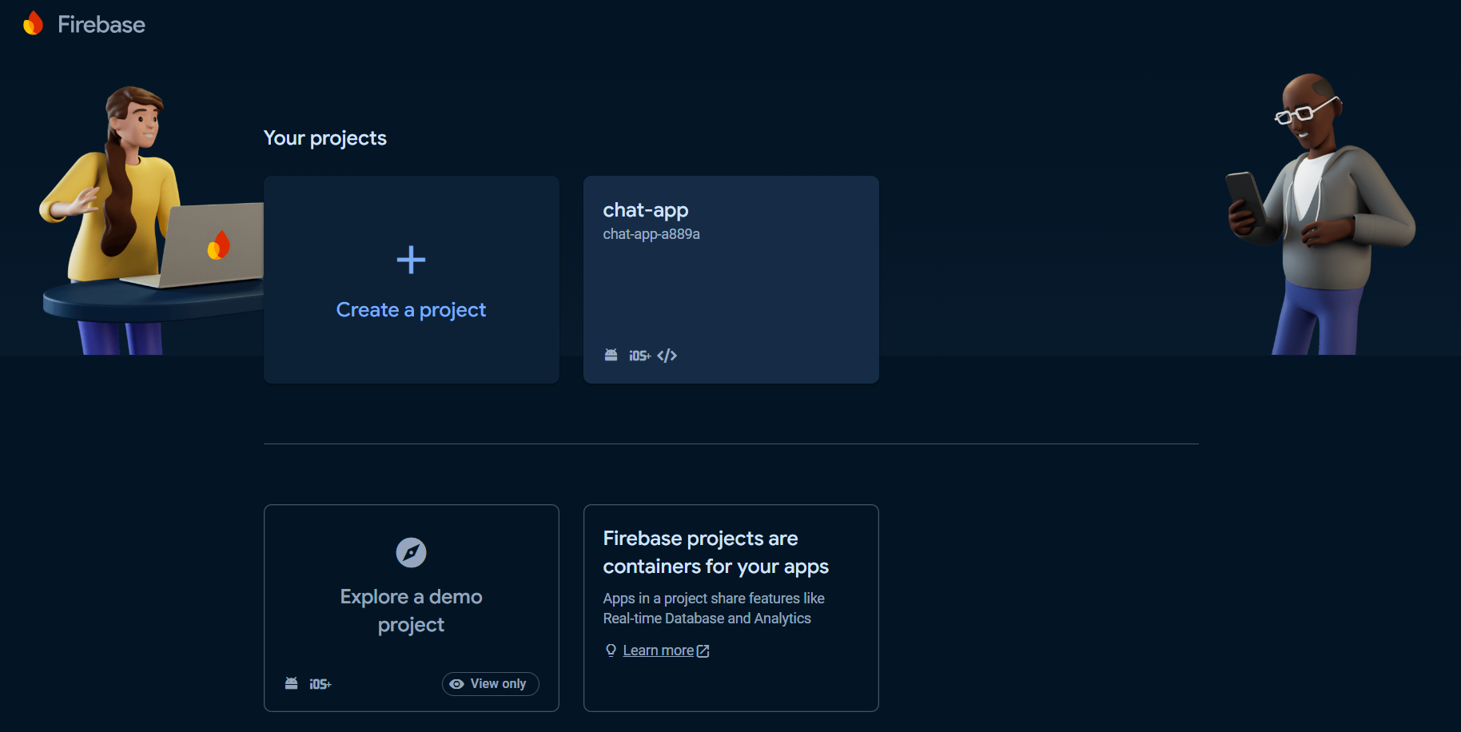
Create New Firebase Project

Slide 10
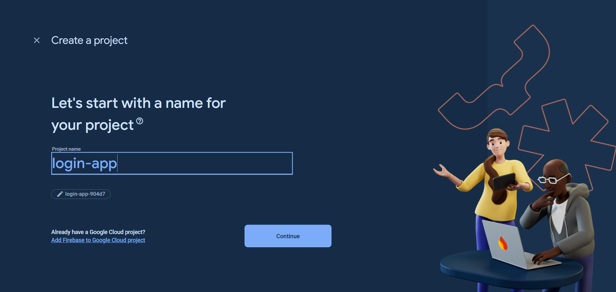
Project Name

Slide 11
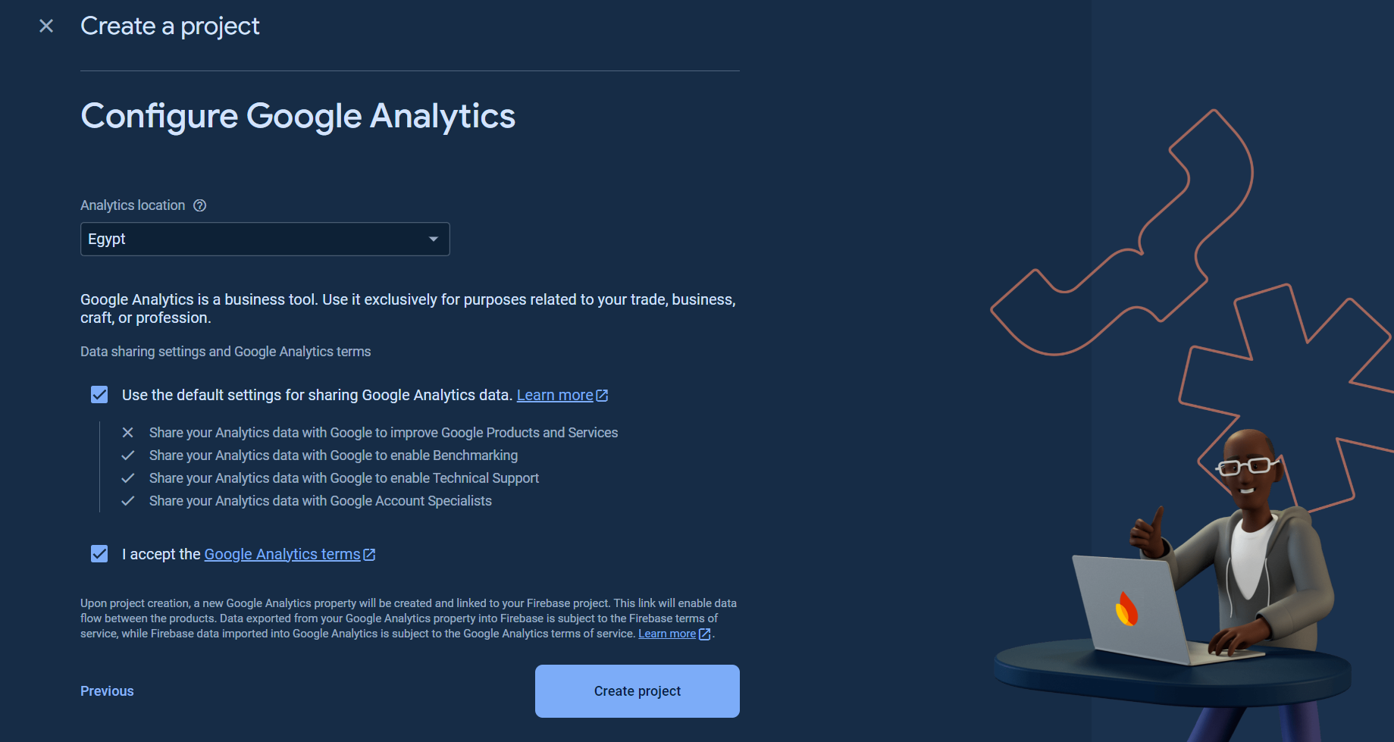
Configure Google Analytics

Slide 12
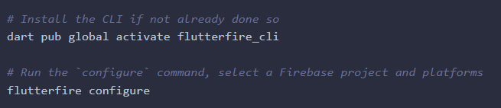
Activate FlutterFire CLI
We can activate it easily using those commands.

Slide 13
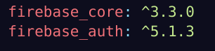
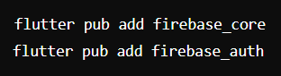
Initialize Firebase core and Add FirebaseCore & FirebaseAuth to project
We can add dependencies manual in pubspec.yaml
Or We can use add it with CLI

Slide 14
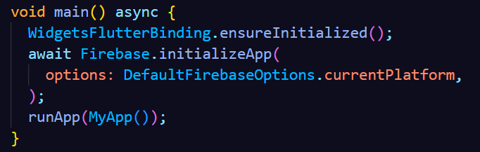
Initialize Firebase in App

Slide 15
03
Login Auth

Slide 16
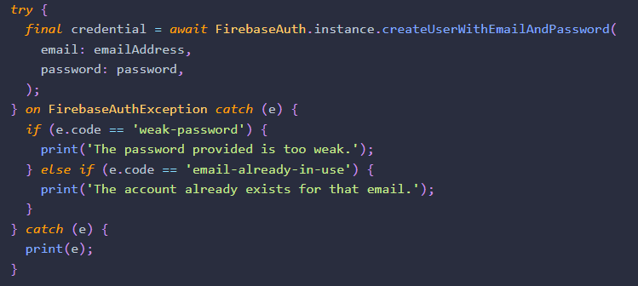
Register
Code with handling Exceptions

Slide 17
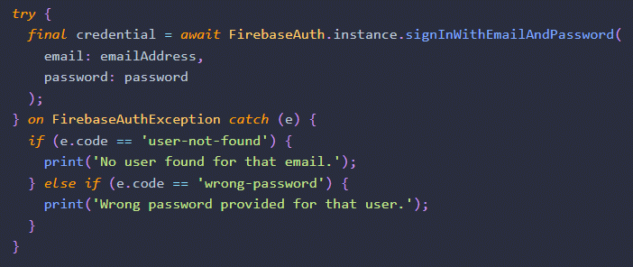
Login
Code with handling Exceptions

Slide 18
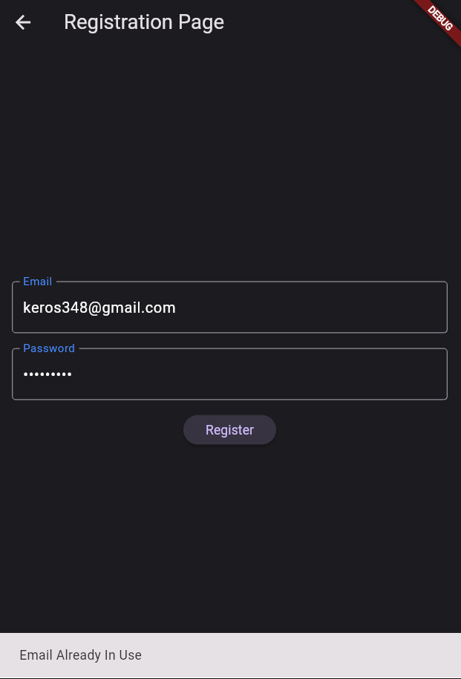
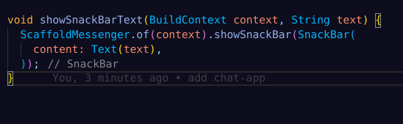
Show Snackbar Widget
Widget to Show message to user if exception happened

Slide 19
Resources
Firebase Install : https://firebase.google.com/docs/cli
Firebase Auth Docs : https://firebase.flutter.dev/docs/auth/overview
Firebase Console : https://console.firebase.google.com
Application Repo : https://github.com/Kero-83/login-app.git

Slide 20
04
Let’s Code

Slide 21
Thank you

